Slide 1
Drive Your Server Like You Stole It
HOTSOS 2017
Andy Weiss & Kirby Sand

Slide 2
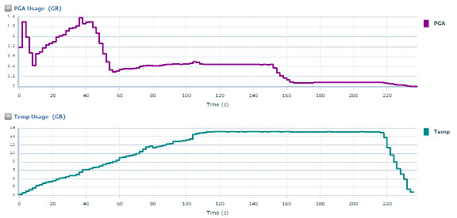
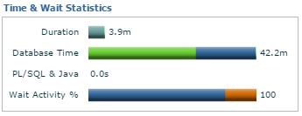
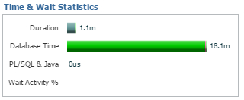
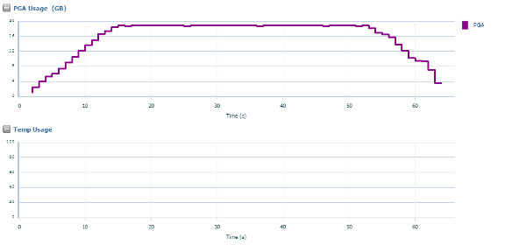
Why are we going to temp?
1.4GB PGA
11.2.0.4
PGA 800GB
72 cores
16GB Temp
Same query with a manual sort area size
19GB PGA
0 Temp

Slide 3
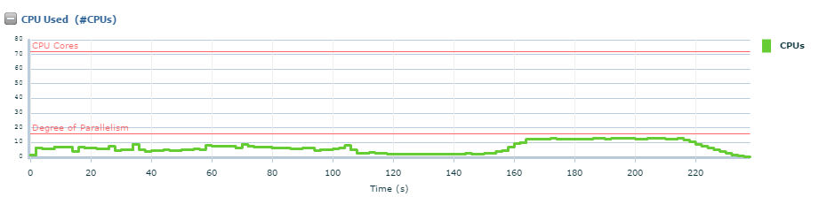
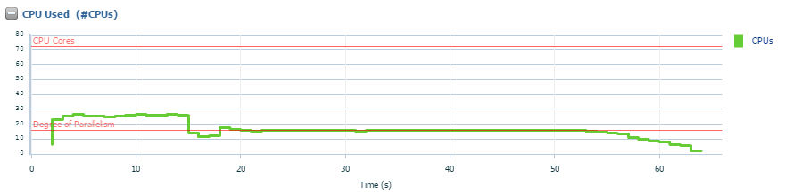
Which also causes inefficient utilization of CPU

Slide 4
Lets set up a test … how hard can it be?
12.1.0.2
512G ram
16 cores
What we thought we new
What we wanted to know
What we actually knew

Slide 5
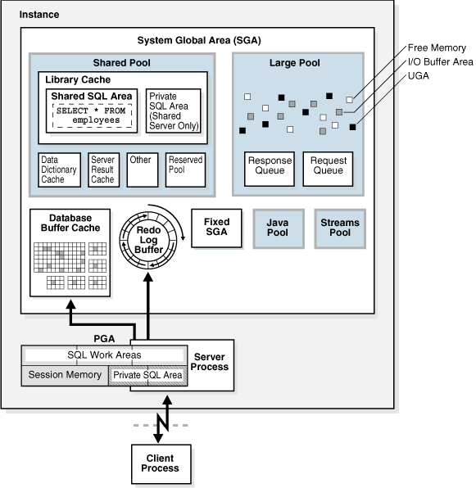
SGA Overview
Quick refresher on SGA memory structures
Areas of interest for us
Buffer Cache
In-Memory Column Store

Slide 6
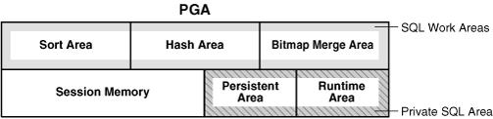
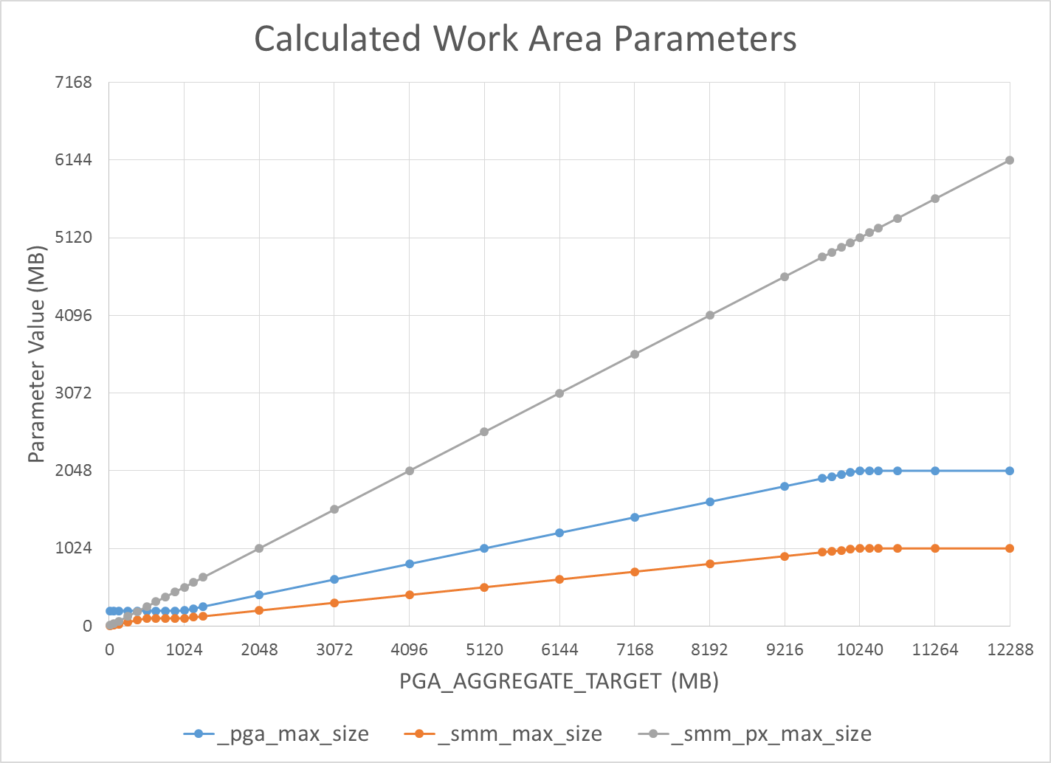
PGA Overview
SQL Work Area
Parallel Execution
_PGA_MAX_SIZE:
PAT < 1GB: 200MB
1GB >= PAT <= 2GB: 20% of PAT
PAT > 2GB: min(2GB, 20% of PAT)
_SMM_MAX_SIZE:
PAT < 512MB: 20% of PAT
512MB >= PAT <= 1GB: 100MB
PAT > 1GB: min(1GB, 50% of _PGA_MAX_SIZE)
_SMM_PX_MAX_SIZE:
Always 50% of PAT
Work Area = min(_SMM_MAX_SIZE, _SMM_PX_MAX_SIZE / DoP)

Slide 7
Automatic Big Table Caching
PARALLEL_DEGREE_POLICY
DB_BIG_TABLE_CACHE_PERCENT_TARGET
V$BT_SCAN_CACHE
V$BT_SCAN_OBJ_TEMPS
Notes:
Only available for parallel queries with a parallel_degree_policy of auto or adaptive
Modifiable but not for PDB
How we got from CACHE(add to hot side of default buffer cache) and KEEP (add to keep pool) to here
Uses temperature of entire object instead of LRU blocks
Will cache partial table to save some I/O. because it looks at the object as a whole you don’t get the thrash that you would with the LRU mechanism.
_small_table_threshold( 2% of _db_block_buffers)
Mem_only mem_part

Slide 8
In-Memory Column Store
You want to do what to my data
Auto or adaptive
DB_BIG_TABLE_CACHE_PERCENT_TARGET 0-90%
Notes:
Jim Czuprynski talk alter lunch took a look at this

Slide 9
Statement Queuing
Parallel_servers_target
Notes:
Parallel_servers_target (PARALLEL_THREADS_PER_CPU * CPU_COUNT * concurrent_parallel_users * 2)
Where concurrent_parallel_users is
Memory_target or sga_target set then 4
Pga_aggregate_target set then 2
Else 1

